Slide 1
NutriSearch

Slide 2
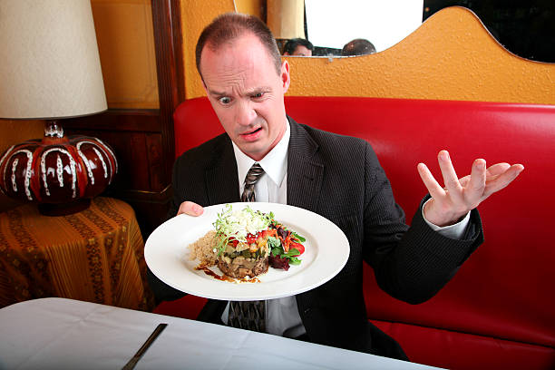
Problem
It is hard to find food in restaurants that suit every diet

Slide 3
Context
People scan menus of many restaurants to find any dishes that suit their dietary preferences. But there is no nutritional information available.

Slide 4
Implications
People in restaurants have to eat nothing or forgo their diet
People do not know food suiting their diet exists at a nearby restaurant
Restaurants lose potential customers

Slide 5
Solution - NutriSearch
Provides nutritional details of dishes served in restaurants
Allows users to filter based on dietary preferences

Slide 6
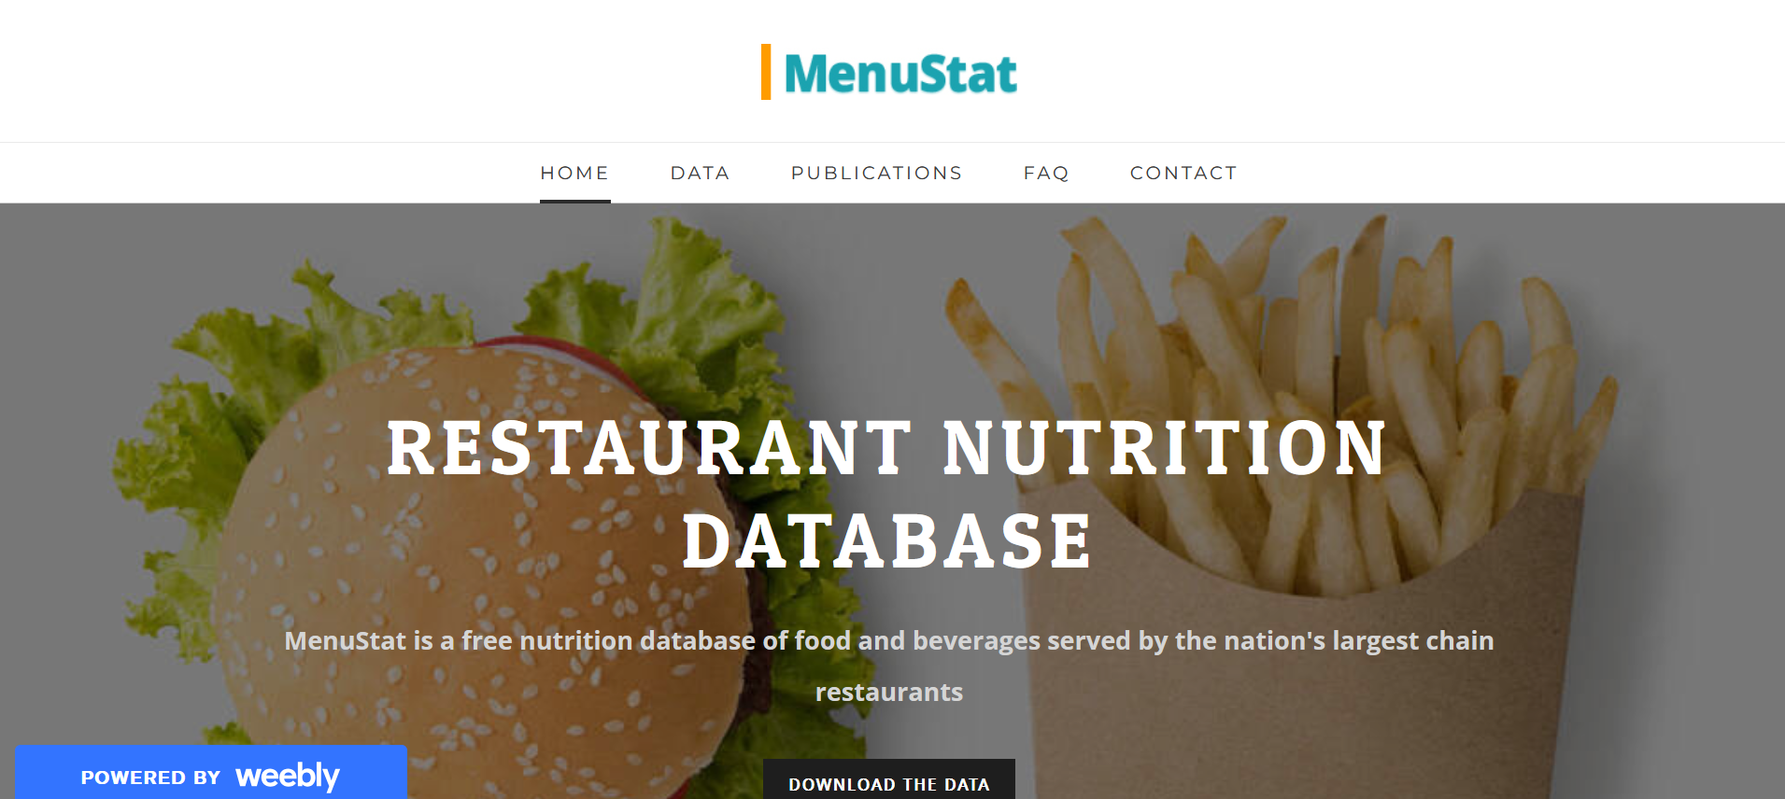
Data

